Slide 1
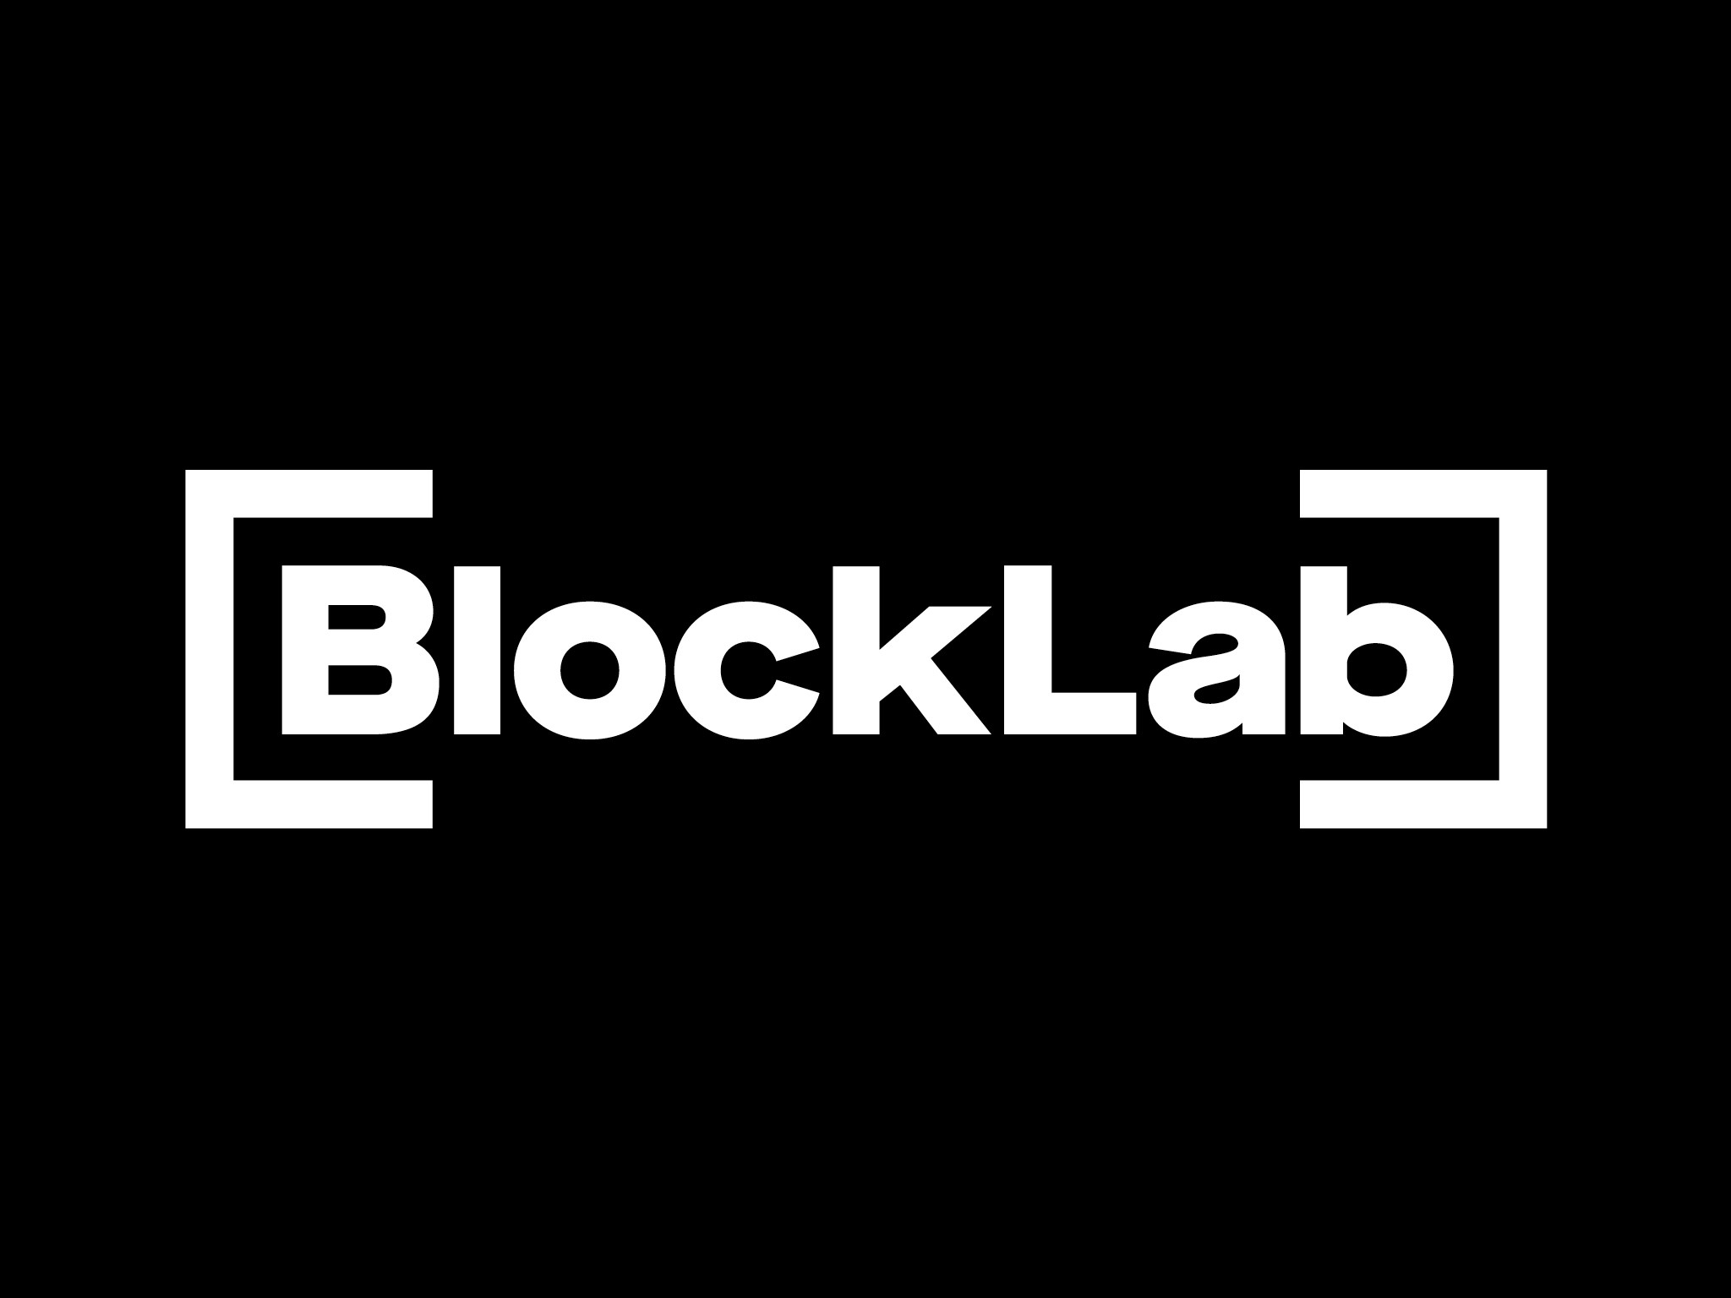

Slide 2
Decentralized container markets (1)
Planning:
The market should bring together supply and demand for container transport.
Current process: shipper or freight forwarder contacts truckers either through phone, mail or in some cases a platform.
Reach is limited to the number of truckers in the address list of the shipper or the number of connected truckers on the platform.
Ideally you want to reach every relevant trucker that is interested in the job, peer-to-peer that is within a certain distance of the port.
Exception handling:
Planning can change owing to unforeseen circumstances, such as:
Delays at previous load- or unload addresses;
Traffic jams;
Unavailability of capacity (trucks, drivers, chassis etc.);
Preferably exception handling should be real-time and based on whether or not the truck can still make the slot-time.

Slide 3
Decentralized container markets (II)
Data:
Example dataset is limited and serves as an indication of the available data.
In reality there are serveral tens of thousands transactions possible per day.
Port of Rotterdam import and export container distribution is skewed. 55%-60% of the containers are import, rest is export.
Container numbers should comply to ISO standard 6346:1995.
Capacity is finit per trucking company.
There are different trailer types. Some trailers can only handle one 20GP container, others can handle two 20GP containers

Slide 4
Decentralized emission exchange
Focus is on the settlement of NoX emmisions.
Emission exchange can be based on future requirements or spot:
Market should bring together supply and demand for both future and spot NoX emission demand.
Compliance period is per year.
Companies are required to measure their actual NoX emissions. You can’t double spent NoX emissions nor can you exchange more NoX emissions than the difference between your actual emission and the allowed emissions.
Emission guidelines (English) : http://www.qp.alberta.ca/documents/Regs/2006_033.pdf
Full audit trail is needed, and parties involved in the settlement should remain unknown to eachother.
Maximum allowed NoX emmissions are dependant on:
Company size.
Type of organization (i.e. logistics, petro-chemical industry, powerplants etc.).
Postal areas within the port of Rotterdam (geo-fencing).
Outside temperature.

